Slide 1
Project:- Healthcare

Slide 2

Team Members
Sampada Joshi
Sayali Thakre
Ashwin Mohan
Jitesh
Vibha

Slide 3
Project Summary
This project was about hospital healthcare focuses on using hospital data to enhance patient care, optimize operational efficiency, and increase revenue generation. By leveraging data about patient stays, the number of doctors, net revenue, total discharges, and types of hospital services, the project aims to make informed decisions, improve patient outcomes, and streamline hospital management processes.
This project uses hospital data to improve operational performance, patient care, and financial sustainability, focusing on areas such as patient stays, staffing levels, revenue generation, discharge processes, and hospital service types. It integrates actionable insights to drive hospital improvement across multiple dimensions.

Slide 4
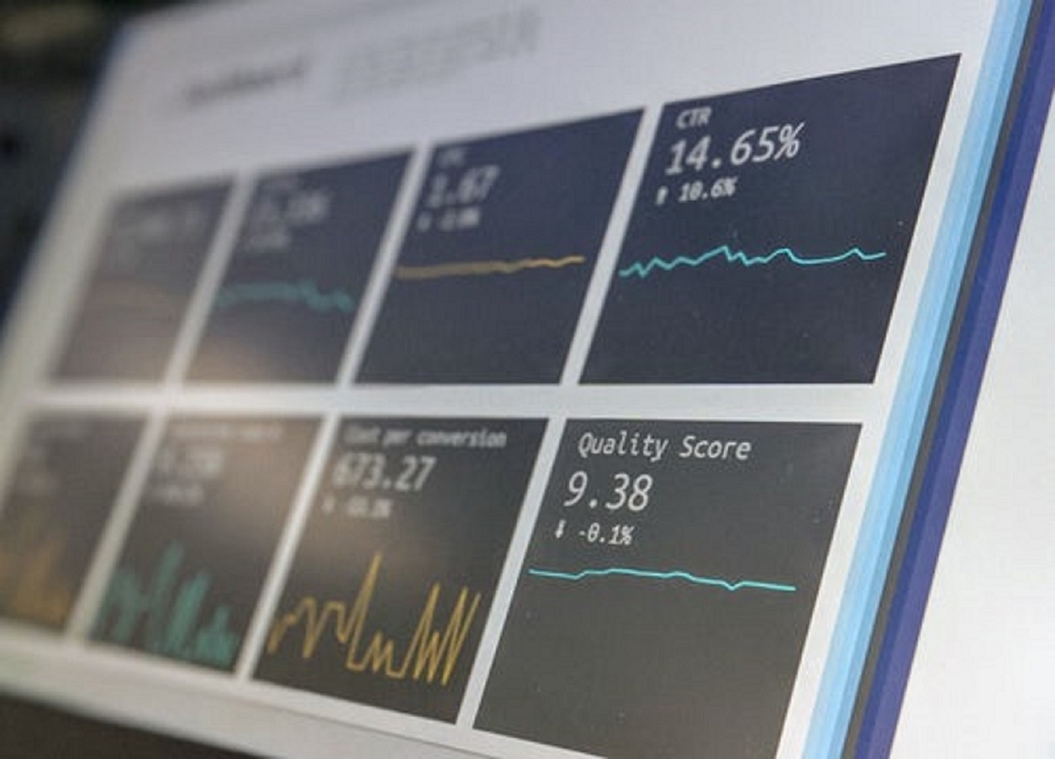
KEY PERFORMANCE INDICATORS
Average patient stays
Total Doctors
Total Patients days
Total Discharge
Net revenue –Hospital wise
Net Revenue –Quarter wise
Top 5 Contywise revenue
Total Net revenue
Availability of beds
This Photo by Unknown Author is licensed under CC BY-SA-NC

Slide 5
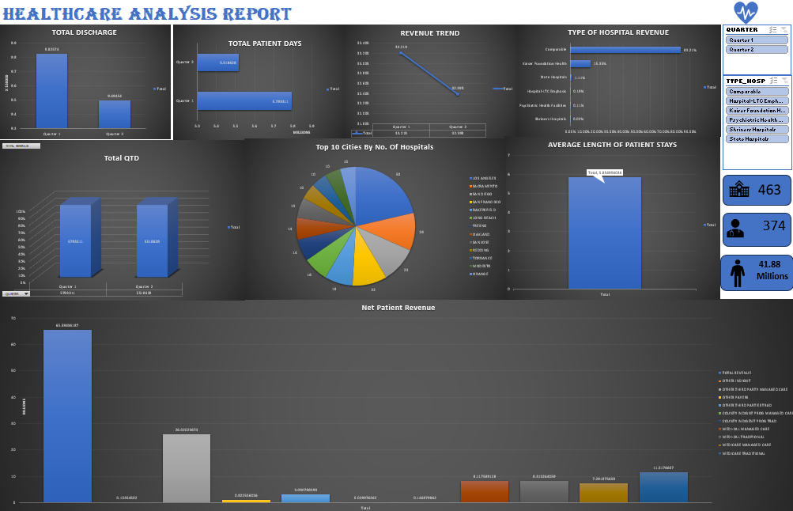
Excel Dashboard

Slide 6
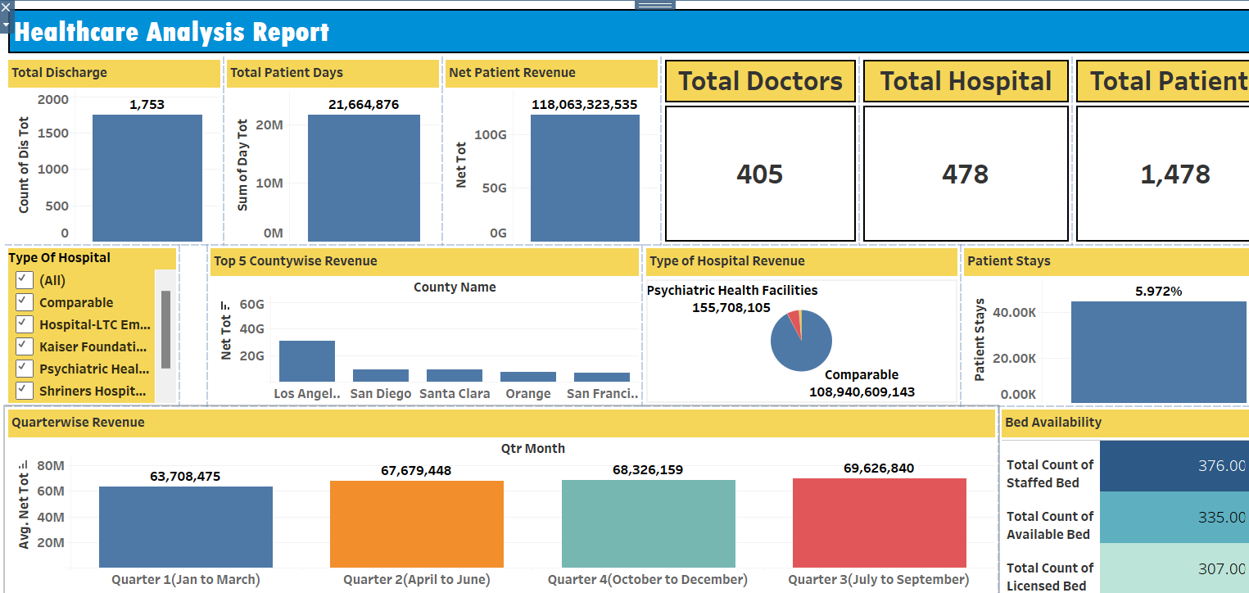
Tableau Dashboard

Slide 7
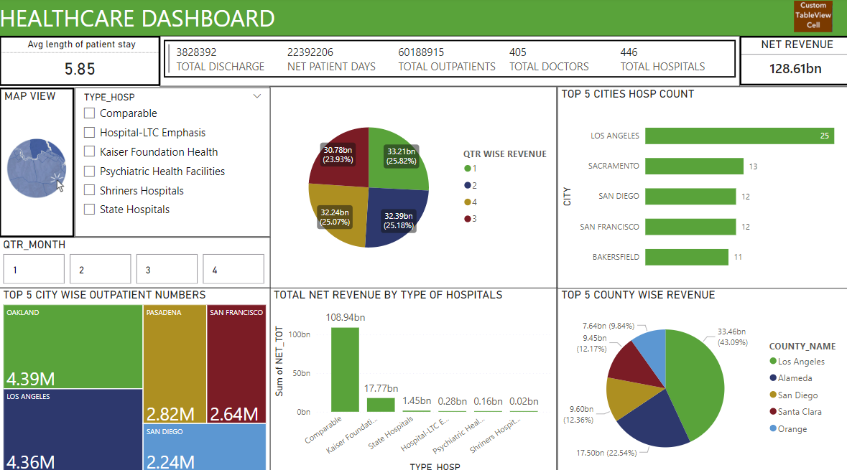
Power BI Dashboard

Slide 8
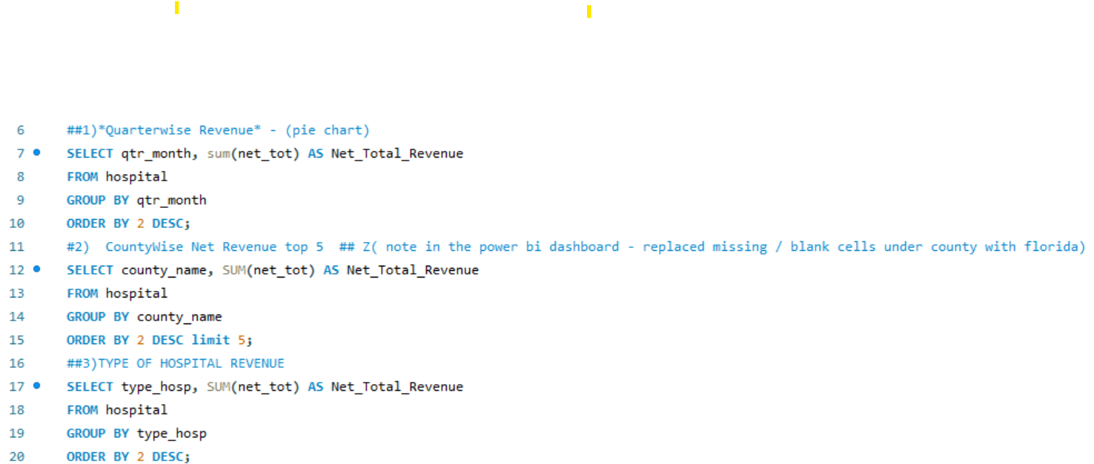
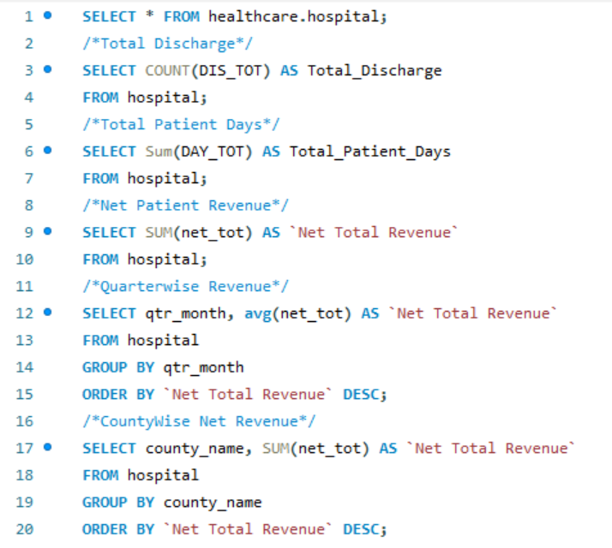
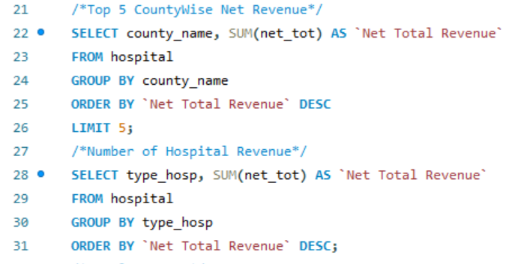
SQL Queries used for Tableau and Power BI

Slide 9
Key Insights
Optimized Resources: Better management of patient stays and staffing to reduce overcrowding and improve workforce efficiency.
Improved Operations: Streamlined discharge processes and smoother patient flow, enhancing hospital efficiency.
Increased Revenue: Data insights help identify profitable services and improve financial management.
Better Patient Care: Focused service offerings lead to improved patient outcomes and satisfaction.
Informed Decisions: Data-driven insights empower strategic decision-making for sustainable growth and continuous improvement.

Slide 10
Thank you

